Slide 1
Products and Software Working Group Interim Meeting, 23 March 2022
Agenda
Software packages status updates (AAPP, IRSPP, MWIPP, CSPP, IMAPP, FY3, …)
Update on JPSS-2
Update on Geo-XO follow-on to GOES-R
Preparations for MTG and EPS-SG
Software packaging including the use of containers (e.g. Docker, Singularity, Podman)
DBNet developments including new monitoring pages and interactions with NWP group on VIIRS clusters on CrIS footprint
PC representation of hyperspectral radiances
PSWG web pages (move to WordPress)
Any other PSWG action items not already covered in the discussion, or topics for next ITSC

Slide 2
Software packages status updates (AAPP, IRSPP, MWIPP, CSPP, IMAPP, FY3, …)
Relevant recommendations
New Recommendation PSWG-2: Software providers should, where possible, offer their software with a choice of either pre-built binaries or source code.
New Recommendation PSWG-3 to Software Providers: For software that will be built from source by the user, software providers should list recommended versions of required external (COTS) libraries.

Slide 3
NWP SAF processors update
AAPP v8: Continuing approximately 6-monthly minor releases
AAPP v9: Will handle pre-processing for MWS and IASI-NG
IRSPP: Version 1.0 released. Supports small sample of MTG-IRS test data released by EUMETSAT in Dec 2019. Expect more test data later in 2022.
Available as source or executables built on Red Hat 7 (noting action PSWG-2)
Feedback welcome! What features would you like to see in IRSPP v2?
MWIPP: Version 1.1 released. Supports MWI and ICI test data released by EUMETSAT in Jan 2021
Includes mapping ICI to MWI to create a 39-channel super-instrument
EPS-SG level 1 processors: Being procured by EUMETSAT. No details available yet. First beta release ~6 months before launch of Metop-SG-A1 (i.e. second half 2023)

Slide 4
CSPP Geo update
The 2022 CSPP Users’ Group Meeting will be held in Madison, Wisconsin on 21 -23 June 2022. Registration and abstract submission are now open: https://www.ssec.wisc.edu/meetings/cspp/2022-meeting/
GOES-18 was launched 1 Mar 2022, and is planned to become the operational GOES-West satellite on an accelerated schedule due to the GOES-17 ABI cooling issues
In the meantime, as a mitigation an “interleaved” GOES-West GRB stream, consisting of ABI data from GOES-18 and other instrument data from GOES-17, is planned during GOES-17 heating periods starting 1 Aug
GRB (Ingestor) Package: No known software updates are needed to process GOES-18 data, but any required updates and configuration recommendations will be issued following interleaving testing in May
Advanced Baseline Imager (ABI) Level 2 Package (AITF)
Version 2.0 beta was released in Jan 2022: adds Derived Motion Winds, Low Cloud / Fog, GOES-17 support for some products, transition to NOAA enterprise algorithms
An update adding preliminary support for GOES-18 is planned in June 2022
Gridded GLM v1.0 planned early this year
ABI Flood Mapping (initial beta) planned early this year
All software, documentation and test data are available on the CSPP Geo website
https://cimss.ssec.wisc.edu/csppgeo/
GeoSphere real-time website: currently adding GOES-17, additional near real-time ABI imagery processed with CSPP Geo software
https://geosphere.ssec.wisc.edu/

Slide 5
Update on JPSS-2

Slide 6
Update on Geo-XO follow-on to GOES-R

Slide 7
Preparations for MTG and EPS-SG
• EUMETSAT are organising User Days on its next-generation satellite programmes, 31 May – 2 June 2022
https://www.eventsforce.net/eumetsat/30/home
The meeting is by invitation, but if PSWG members have particular requests or questions, Nigel would be happy to raise those points at the meeting.
• EUMETSAT have made available a number of test datasets. Expect more in the next year:
https://www.eumetsat.int/mtg-test-data
https://www.eumetsat.int/eps-sg-user-test-data

Slide 8
Software packaging including the use of containers (e.g. Docker, Singularity, Podman)
Relevant actions and recommendations
New Action PSWG-4: CSPP and IMAPP teams to share UW/SSEC/CIMSS experiences on working with containers (Docker, Podman, Singularity), including lessons learnt, via the PSWG web site.
New Action PSWG-5: CSPP and IMAPP teams to provide information on running Linux packages in Windows, via the PSWG web site.
New Recommendation PSWG-6 to Software Providers: Software providers are encouraged to provide and test software in a cloud-ready format
Jim Davies: Develop / Deploy with Singularity https://www.ssec.wisc.edu/~jimd/Singularity/Singularity_Pattern_Practice.pdf

Slide 9
DBNet developments including new monitoring pages and interactions with NWP group on VIIRS clusters on CrIS footprint
Relevant action
New Action PSWG-1: PSWG co-chairs to liaise with the ASWG and NWPWG co-chairs with the aim of agreeing a coordinated approach to the cluster analysis of VIIRS radiances on the CrIS footprint.
VIIRS clusters on CrIS field of view
DBNet alternative data distribution via WIS (potentially allows full-channel products - Liam following this up)
DBNet traffic light system and email alert system: https://nwp-saf.eumetsat.int/monitoring/ears_mon/DBNet_station_status.html
New IASI monitoring pages from Meteo-France (Mathieu Asseray and colleagues) - following slides

Slide 10
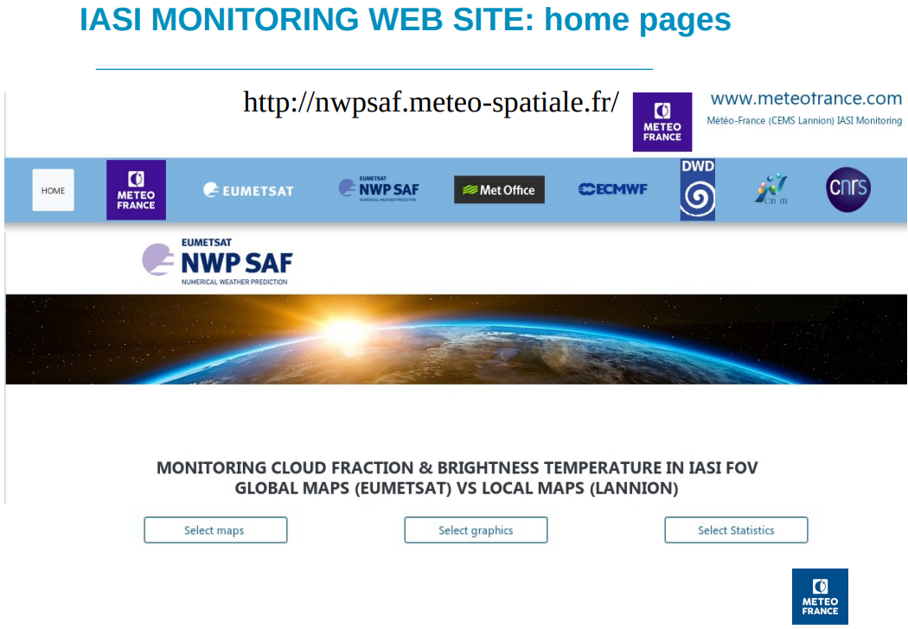

Slide 11
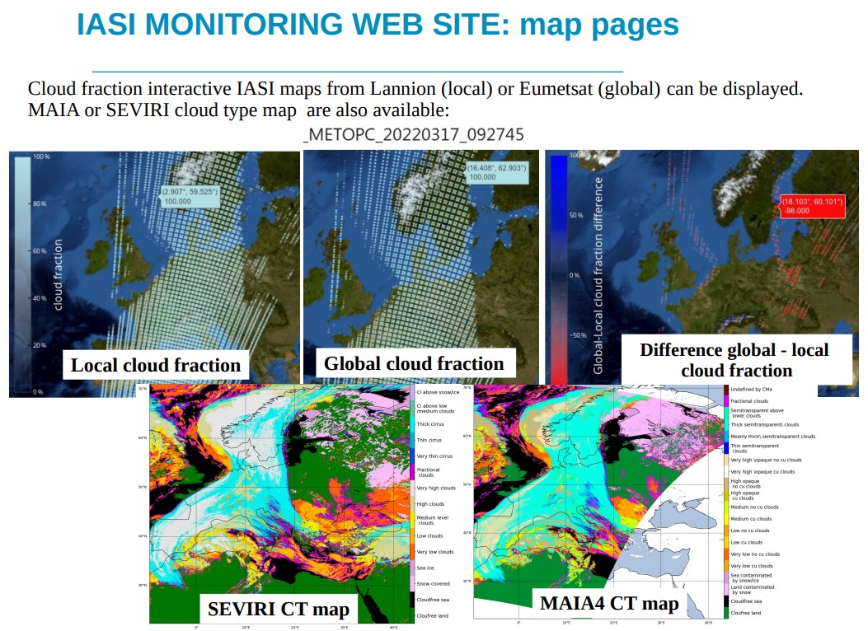

Slide 15
PC representation of hyperspectral radiances
Relevant action
New Action PSWG-2: PSWG co-chairs to monitor developments in PC representation, liaising with the ASWG, and report back to PSWG at the next ITSC.
CrIS SDR hybrid PCA development

Slide 16
PSWG web pages (move to WordPress)
Leanne: “We are going to redesign the ITWG site and move it into WordPress BEFORE the next ITSC”

Slide 17
Any other PSWG action items not already covered in the discussion, or topics for next ITSC
Relevant actions and recommendations
New Action PSWG-3: Nathalie Selbach, and others in PSWG who are able to do so, to test new NOAA/CLASS access options, including cloud access, and report back to PSWG.
New Recommendation PSWG-1: NOAA, JAXA and the CSPP team to continue exploring ways in which the AMSR-2 level 1 software and direct broadcast transmission availability could be shared with DB users.
New Recommendation PSWG-4 to Agencies: Costs to users should be considered when migrating software and data distribution to the cloud.
New Recommendation PSWG-5 to Agencies: Users should continue to have free access to satellite data.
Completed actions
New Action PSWG-6: PSWG co-chairs to provide feedback on the High Level Priority Plan and CGMS Best Practices document to ITWG co-chairs by end 2021.
New Action PSWG-7: Paul Menzel and Tony Reale to send a few sentences summarising their validation studies to the PSWG co-chairs, for inclusion in High Level Priority Plan feedback.
Additional topics?

