Slide 1
NOAA's Plans for Hyperspectral IR Sounding from a Geostationary Orbit
ITWG Sounder WG
March 24, 2022
Andy Heidinger, NESDIS GEO Senior Scientist
Pam Sullivan, GeoXO Program Director
Dan Lindsey, GOES-R Program Scientist
Joel McCorkel, GeoXO Project Flight Scientist
Tim Schmit, GXS SWG Lead and Product Scientist
NOAA
National Environmental Satellite, Data, and Information Service

Slide 2
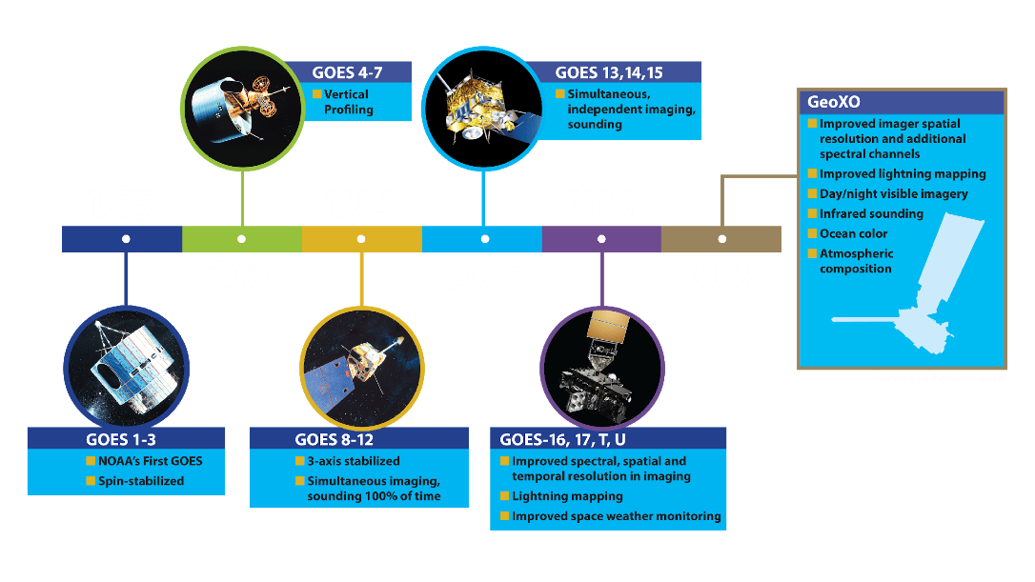
Generations of Geostationary Operational Environmental Satellites

Slide 3
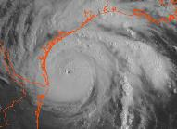
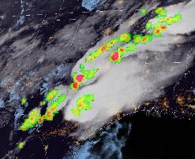
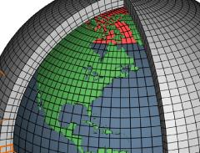
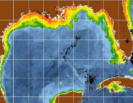
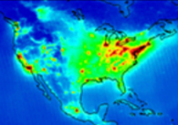
GeoXO: Mission Needs Served
Ongoing Needs: Users require continuity of existing observations with improved performance
Data for short-range forecasting, severe weather watches and warnings, and monitoring hazardous environmental conditions including tropical storms, severe storms with lightning and damaging winds, snow, ice, flooding, fog, fires, smoke, and volcanic ash.
Delivered by Imager and Lightning Mapper
Growing Needs: Users expect NOAA to meet new requirements with new observations:
Improved numerical weather prediction and local nowcasting
Delivered by Hyperspectral IR Sounder
Monitoring dynamic coast/ocean features, ecosystem change, water quality, and hazards
Delivered by Ocean Color Instrument
Monitoring air quality and linkage with weather and climate
Delivered by Atmospheric Composition Instrument
Vis/Near-IR Imagery
[Supporting NWS]
Lightning Mapping
[NWS]
IR Sounding
[NWS]
Ocean Color
[NOS, NMFS]
Atmo. Composition
[OAR, NWS]

Slide 5
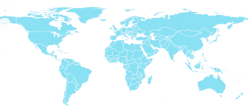
GeoXO within the GEO-RING
GeoXO User Readiness will rely heavily on non-NESDIS proxy data
Legend
Satellites In Orbit
GOES-R
Imager
LM
GOES-R
Imager
LM
MSG
Imgr
MSG
Rapid
MSG
Imgr
Elk-L
Imgr
I-3DR
Imgr
Sndr
FY2
Imgr
FY4
Imgr
Sndr
LM
GK2A
Imgr
GK2B
AC
OC
H8/9
Imgr
OC Proxy
FY4
Imgr
LM
GK2B
AC
✔️
2020s
2030s
AC Proxy
MTG-I
Imgr
GK2B
OC
Sndr Proxy
FY4
Sndr
✔️
MTG-S
Sndr
I-3DS
Imgr
Sndr
✔️
Imgr Proxy
NASA
TEMPO
MTG-I
LM
LM Proxy
MTG-I
Rapid
MTG-S
AC
✔️ = in orbit
NASA
GLIMR
Planned
Satellites
GEO-I
Imager
LM
OC
GEO-S
Sounder
AC
GEO-I
Imager
LM
OC
MTG-I
Imgr
LM
MTG-S
Sndr
AC
MTG-I
Rapid
LM
I-3DS
Imgr
Sndr
FY4
Imgr
Sndr
LM
GK3
Sndr
GK3
Imgr
LM
H10
Imgr
tbd
New Capabilities
Preliminary and Pending Approval
Notes:
Pursuing dialog with NASA on Earth observation cooperation
Supports National Academies 2017 Decadal Survey recommendation: “NOAA should establish, with NASA, a flexible framework for joint activities that advance the capability and cost-effectiveness of NOAA’s observation capabilities.”
Participating in a study with the Canadian Space Agency (CSA) on potential Arctic mission
Continue to lead and sponsor initiatives in CEOS, CGMS, WMO, WCRP, GCOS and other relevant bodies to advance GEO Ring vision
Continue dialogue with partners and user needs assessments including partner inputs

Slide 6
The GeoXO Sounder (GXS)
Preliminary and Pending Approval

Slide 7
GeoXO : GXS Summary (What and Why)
Attribute |  | What |  | Why
Coverage |  | Ideally: Sounding Disk as seen from both GOES-East and –West positions; Central satellite position currently planned |  | The Atlantic for hurricane development and model initializations, CONUS for the pre-convective environment monitoring and the Pacific for both upstream weather and monitoring moisture (and winds) over the huge area with little conventional data.
Spatial Resolution |  | 4 km (at the satellite subpoint) |  | Doubling the clear-sky yields, compared to LEO, for a given time. Also for finer moisture gradients to be monitored.
Temporal Resolution |  | Sounding Disk (30 min) or Sounding Disk (60 min) + CONUS (15 min) + Mesoscale (5 min) (TBD) |  | Sounding Disk upstream information and hurricane monitoring (improved track and intensity), CONUS for pre-convective monitoring and the targeted for regions of extremely active weather. Allows for clouds to move out and obtain more clear sky information.
Spectral Coverage / Resolution |  | ( 680 - 1095 cm⁻¹ 14.7 – 9.13 μm 1689 – 2250 cm⁻¹ 5.92 – 4.44 μm ) @ ~0.6 cm-1 |  | Spectral with information related to temperature, moisture and support select atmospheric compositions (ozone, NH3, isoprene, HNO3, N20 and CO). Need to resolve, not average out, the critical on/off spectral lines.
Other |  | Evolution of the radiances |  | Provides critical vertical information on atmospheric winds for both nowcasting and NWP applications.

Slide 8
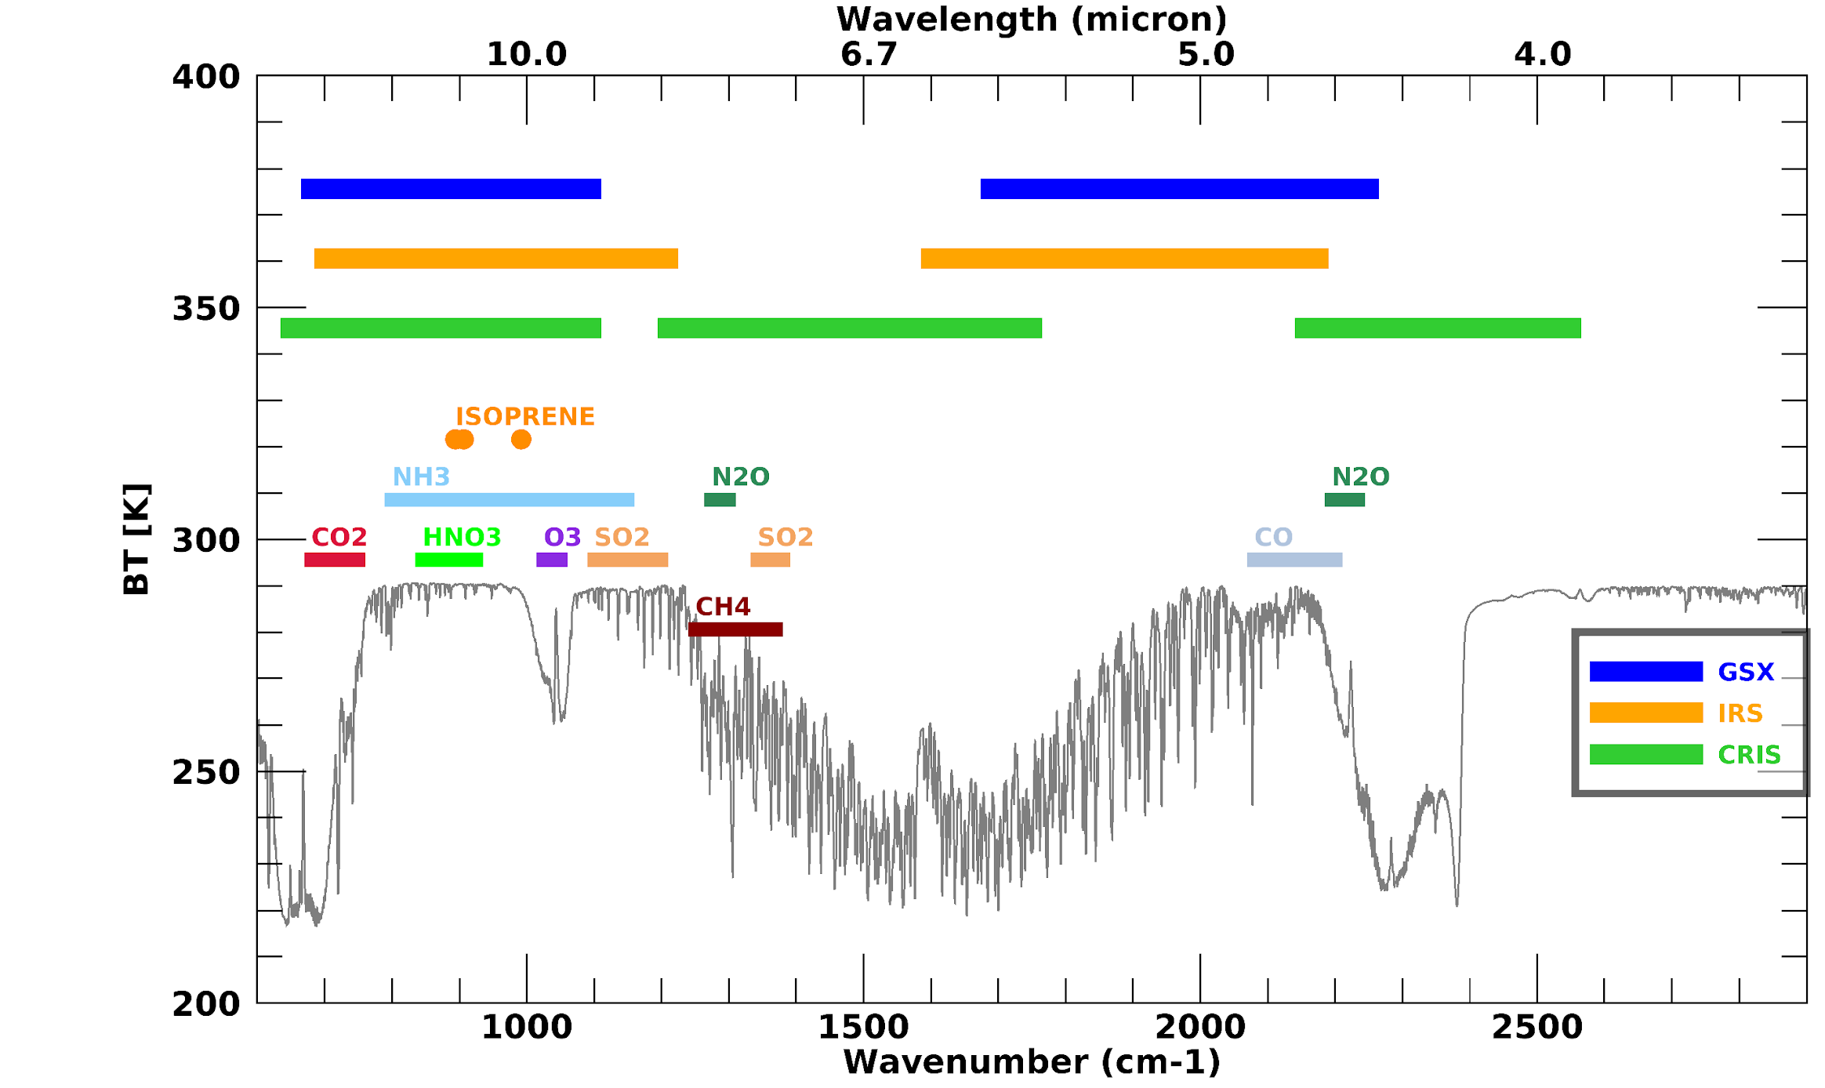
14.7 um
9.13 um
5.92 um
4.44 um
Spectral coverage baseline performance
Spectral resolution reflects that of the CO₂ features that provide vertical temperature information.
Water vapor band resolution matches that of the European MTG-IRS instrument that will provide valuable test data to NOAA for
future algorithm validation.
680 cm⁻¹
1095 cm⁻¹
1689 cm⁻¹
2250 cm⁻¹

Slide 9
GXS Activities
Preliminary and Pending Approval

Slide 12
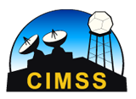
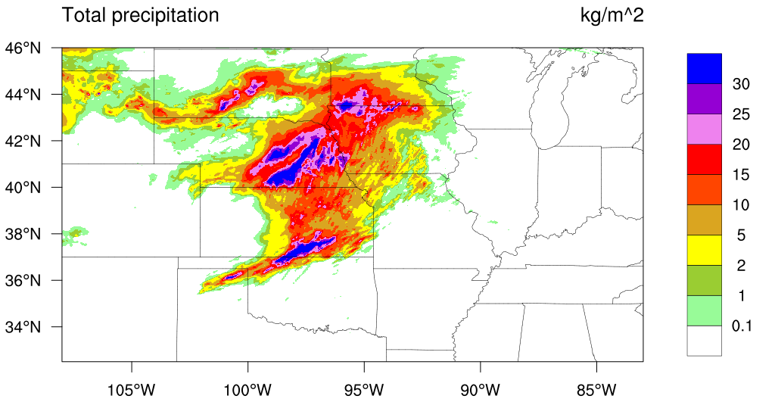
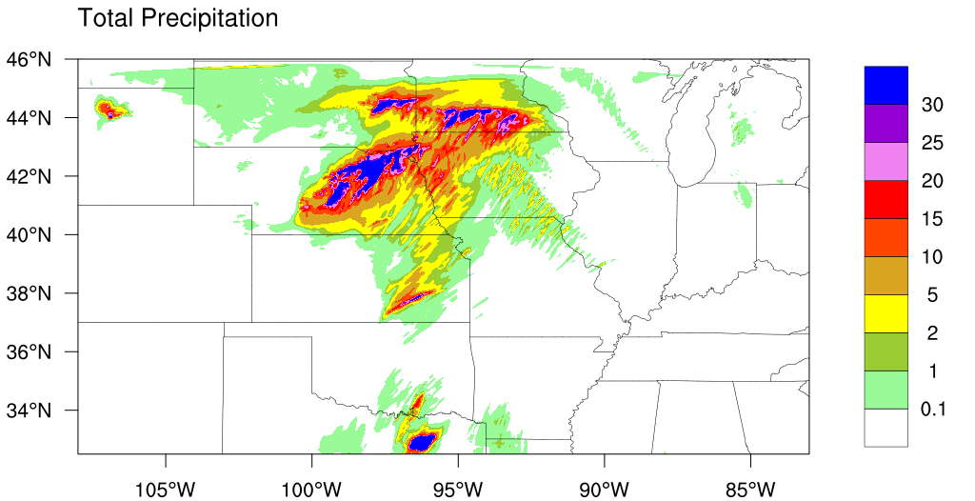
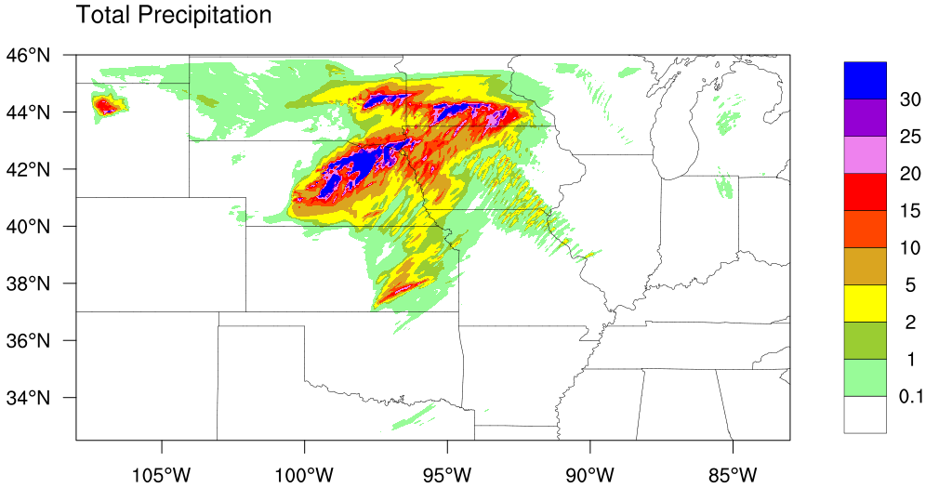
Hybrid OSSE: Precipitation Impact Verification
Observation
2019-5-27 06z – 12z
The high spectral IR was able to remove a spurious storm over Eastern Texas!
A false heavy precipitation that might lead to a false warning!
CNTRL
No “GXS”
EXP
With “GXS”

Slide 13
GeoXO GXS Sounder Working Group
GeoXO is supporting many more sensors and serves many more communities than GOES-R and has therefore established Science Working Groups to manage this.
SWG have 3 principal scientist members:
Instrument: David Johnson (NASA LaRC)
Product: Tim Schmit (NESDIS/STAR)
User: Jim Yoe (NOAA/NWS/EMC)
We are using the SWG to help guide the GXS formulation, GXS L2 (not defined by GeoXO) and GXS User Readiness.
We will grow GeoXO SWGs as needed, and we welcome all interested parties to attend our monthly meetings.
Starting Fy24, we will contribute to the NESDIS Enterprise Proving Ground which will solicit innovative proposals from the US community.

Slide 14
GeoXO Welcomes Your Help in Advocating for GXS
GeoXO is busy establishing value. Ideas on application that will benefit in quantifiable ways from GXS are needed.
Our existing GXS studies have produced estimates of improvements in temperature, moisture and wind field. We need documented statements of benefit that are compelling to the US Govt Funding Bodies.
GXS will provide how many additional minutes/hours of lead time for severe storms?
GXS Winds will improve hurricane track forecasts by how many km?
A Successful use of MTG/IRS might be critical to securing GXS on GeoXO.
Help us leverage the relevant European activities
Help us identify key gaps in the US activities that we can help fill.

Slide 15
Thank You!
NOAA NESDIS Tech Report: Geostationary Extended Observations (GeoXO) Hyperspectral InfraRed Sounder Value Assessment Report
https://repository.library.noaa.gov/view/noaa/32921
GeoXO
https://www.nesdis.noaa.gov/next-generation-satellites/geostationary-extended-observations-geoxo
Preliminary and Pending Approval

Slide 16
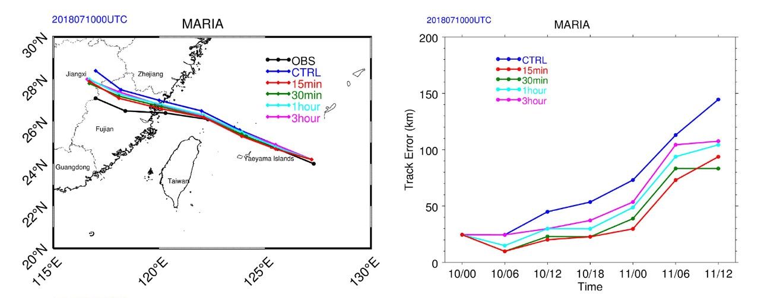
Improved track and intensity forecasts
Improving tropical cyclone forecasts with high temporal/spectral IR observations.
Track & intensity forecasts for Typhoon Maria are most improved with 15 min data, the track (> 40%) and the intensity (18%).
Precipitation forecasts also improved.
The 36 h track forecast for Typhoon Maria from 0000 UTC on July 10, 2018. The black, blue, red, green, cyan, and magenta lines indicate the Best Track, control experiment, 15 min, 30 min, 1 and 3 h, respectively. https://agupubs.onlinelibrary.wiley.com/doi/10.1029/2021GL093672

Slide 17
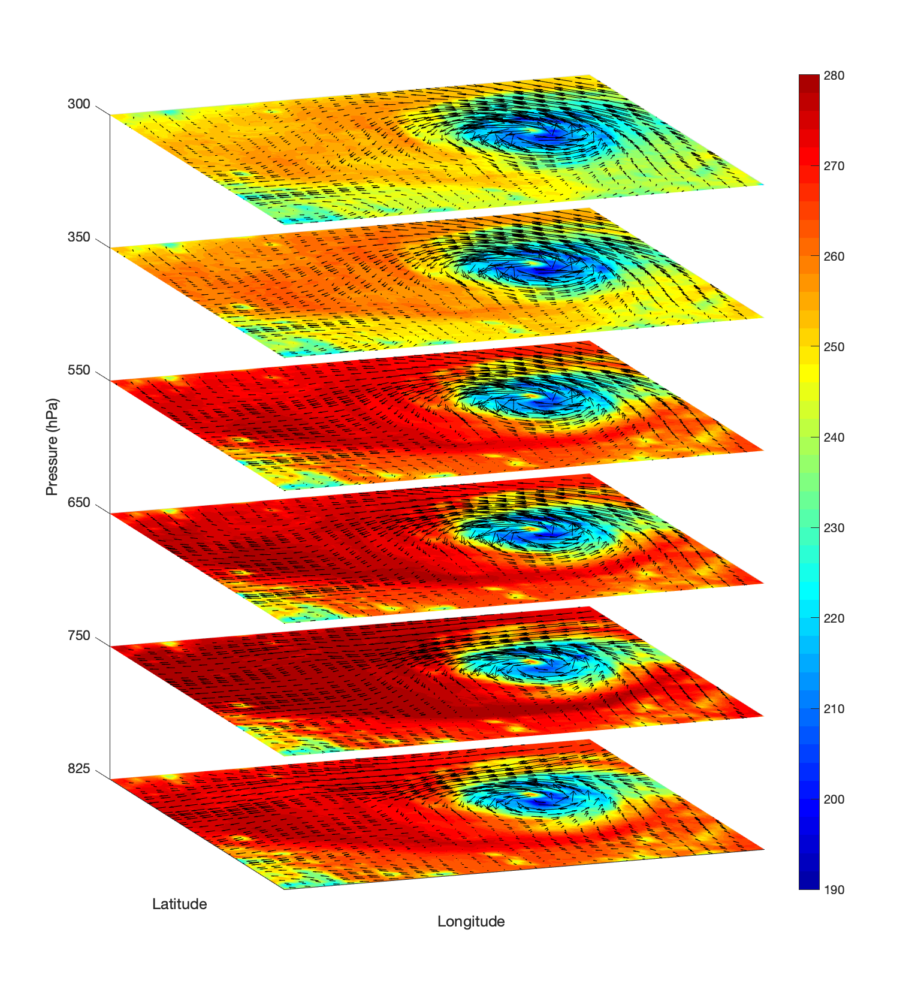
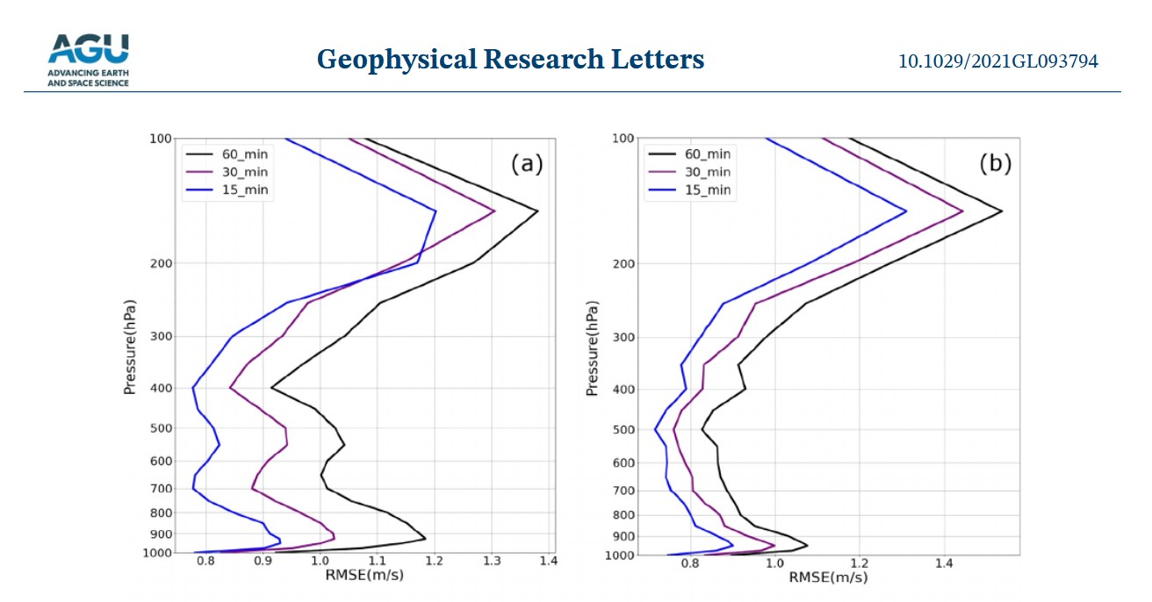
Why 15-min? (GIIRS and ABI)
https://agupubs.onlinelibrary.wiley.com/doi/10.1029/2021GL093794
Using 15-min Geosynchronous Interferometric Infrared Sounder (GIIRS) observations, … and higher temporal resolution provides better 4D wind fields than the lower temporal resolution.

Slide 18
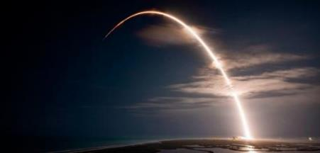
GeoXO has Begun
Formulation Phase is planned over 2022-2025 and will include:
Industry studies for candidate instruments
Finalization of partnerships for system elements
Initiation of major flight element acquisitions
Benchmarking and pilot projects to inform Ground system definition
Continued user needs assessments to define system, products, services
Stay engaged with NOAA’s Pathfinder Program to help us develop GeoXO!
GeoXO will continue and advance NOAA’s observational capabilities through 2050
For more info: https://www.nesdis.noaa.gov/GeoXO

Slide 19
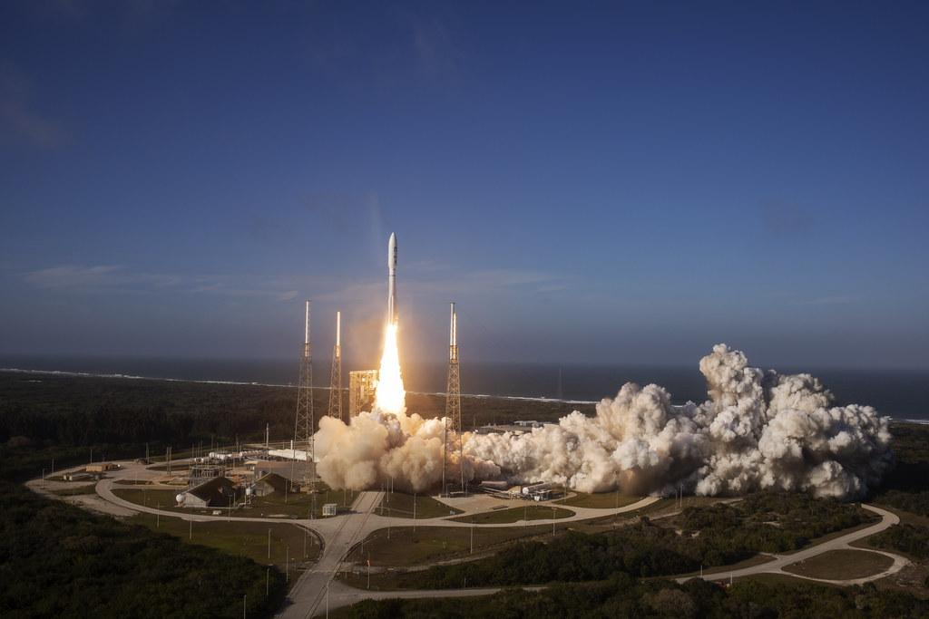
GOES-T
Launches!

Slide 20
Top level GSX baseline performance
Parameters | Baseline performance
Spatial resolution at nadir | 4 km
Temporal update rate | 62-degree LZA disk in 30 minutes
Spectral range | Temperature, Moisture, Window, and Ozone
Day Night Band: Waveband | Panchromatic in in the visible to near infrared (approximate example 0.5-0.9 um)
Day Night Band: Spatial resolution at nadir | 0.5 km
DNB SNR at ¼ moon illumination | 6:1

Slide 21
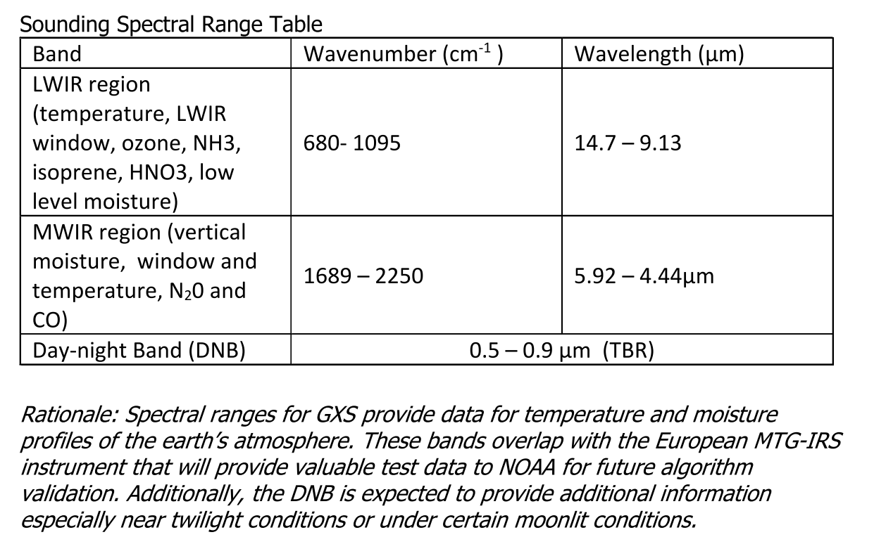
GXS PORD Information

Slide 22
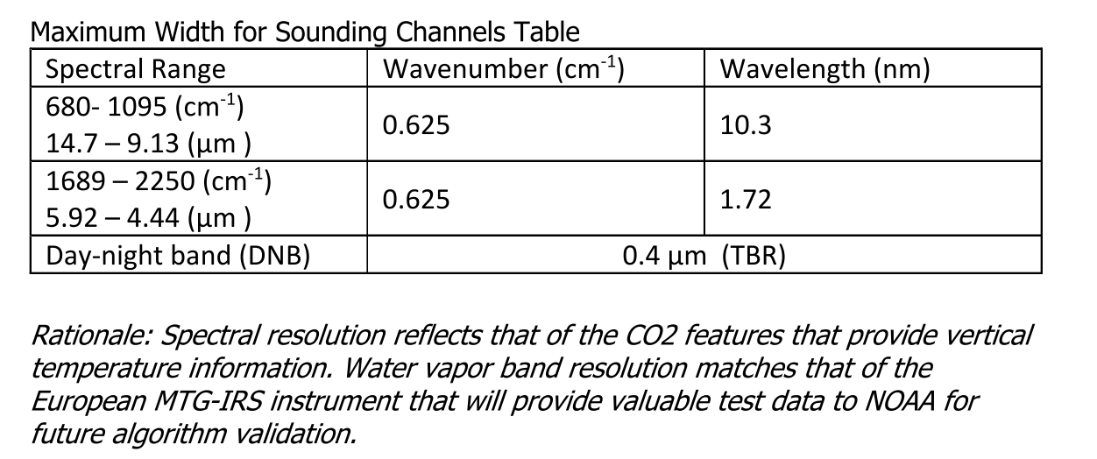
GXS PORD Information

Slide 23
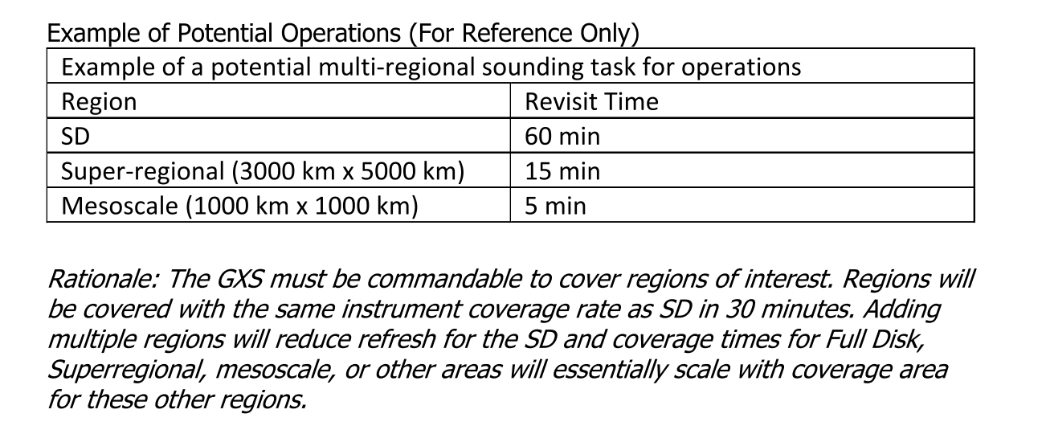
GXS PORD Information

Slide 24
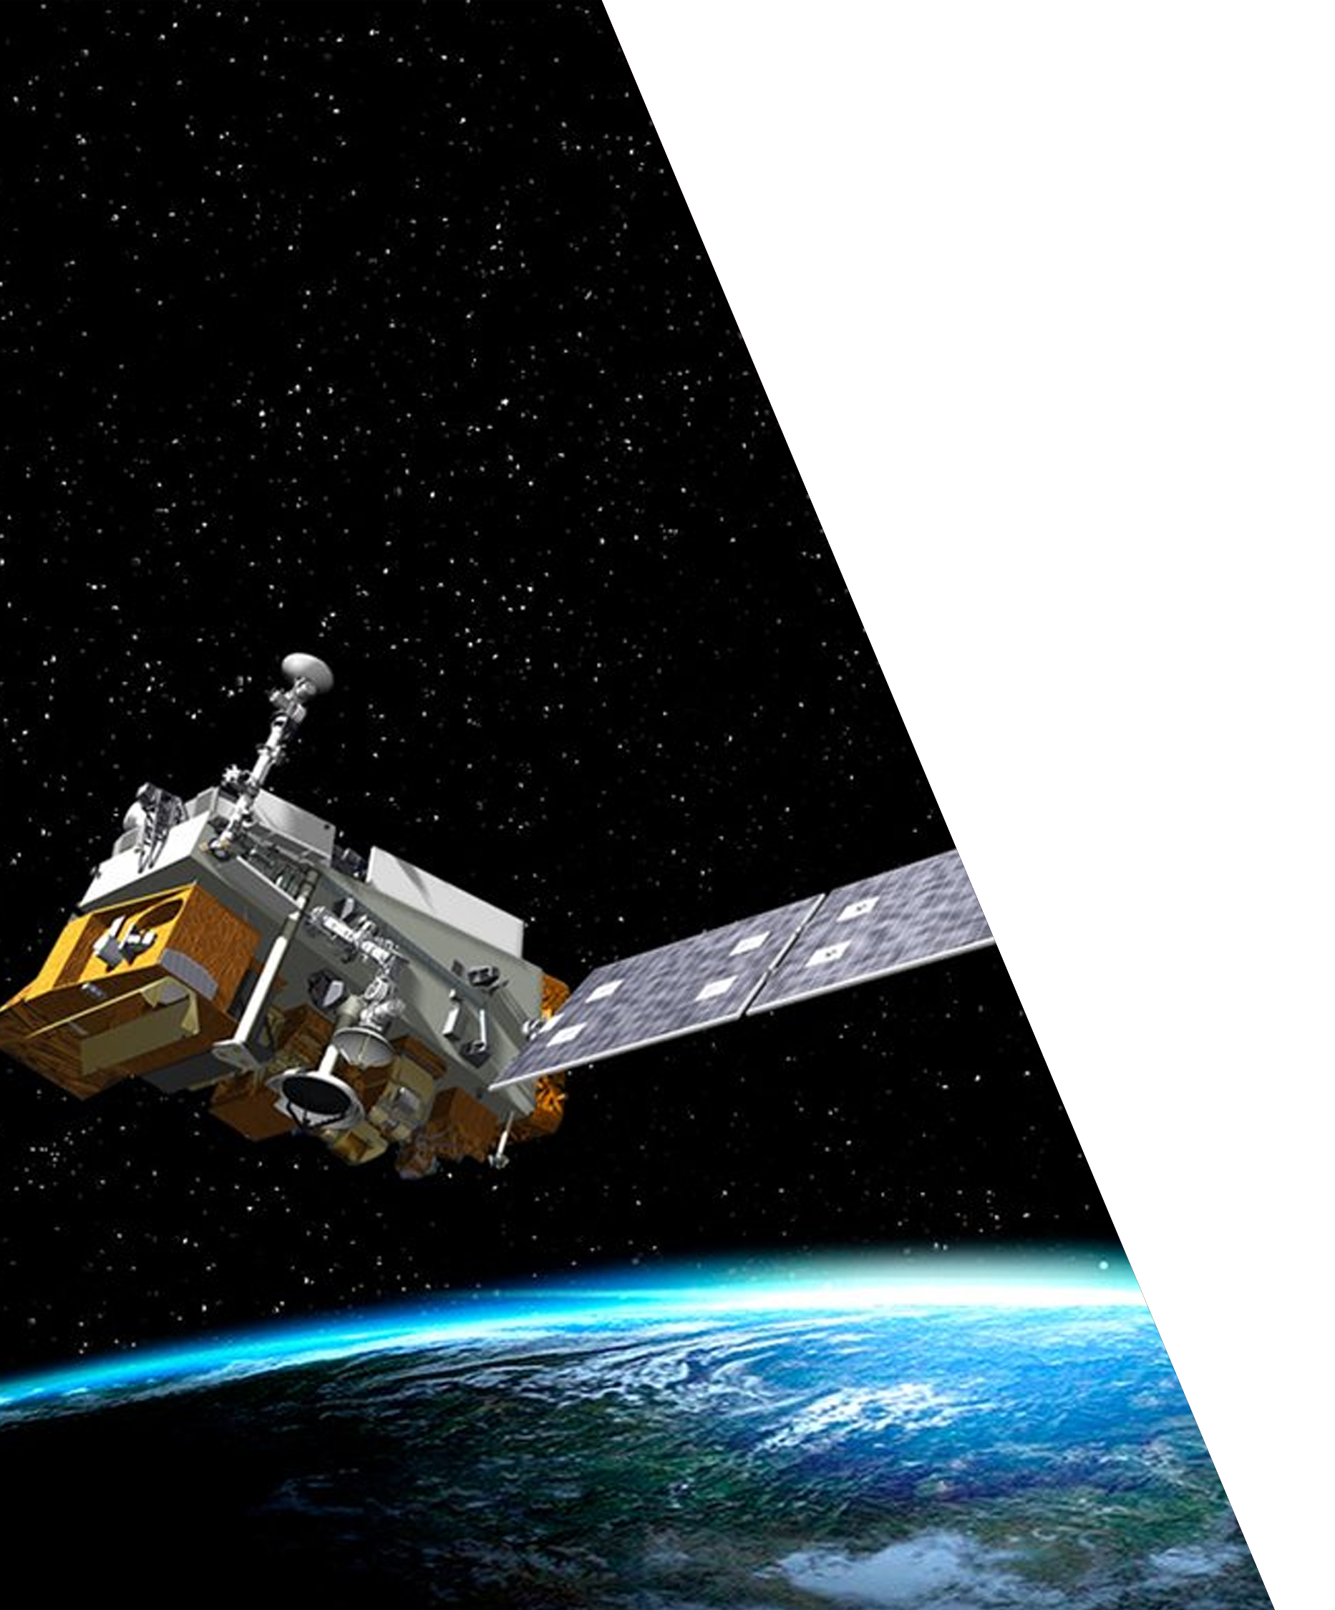
Compact Hyperspectral Infrared Sounding Interferometer (CHISI) Phase III SBIR
JV POC: Dave Spencer
Lower risk (by evaluating current breadboard calibration accuracy and measurement sensitivity) of innovative ‘push-broom’ approach to IR Sounding that promises better performance and lower cost than current IR sounders
Purpose/Benefits of Project
Lowering cost LEO Infrared Sounding
Increasing NESDIS sensor-vendor base to include non-traditional contractors
Performance verification to make attractive to outside commercial investment
Potential sensor for Commercial Weather Data for NOAA
First NOAA Sole Source SBIR Phase III
CHISI Breadboard

Slide 25
GeoXO Has Officially Begun
The Milestone 1 approval by the Deputy Secretary of Commerce in November 2021 formally initiated the Geostationary Extended Observations (GeoXO) program
Approved GeoXO to enter the formulation phase which allows the program to develop the mission concept for formal approval, which occurs at Milestone 2, planned in late 2022
The GeoXO program described herein is as proposed at Milestone 1
Prioritized descopes are defined in the event that proposed program budget is not approved
Targeting first GeoXO launch in 2032
We are here
Preliminary and Pending Approval

Slide 26
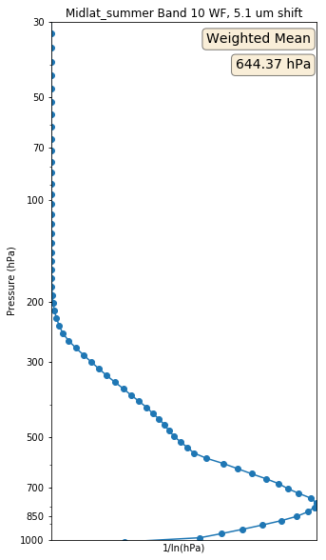
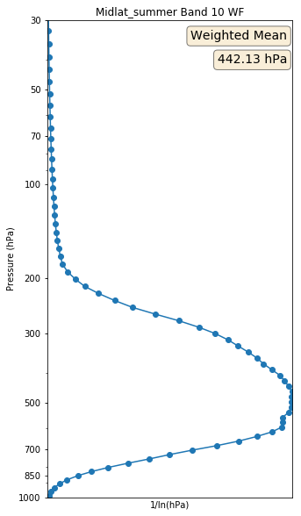
5.1 µm Water Vapor Band
Plots on the right show estimated weighting functions of a 5.1 µm band (left) and the ABI 7.3 µm band (right) (Courtesy of Nate Miller, Mat Gunshor and others from CIMSS)
The ABI 7.3 µm band is nicknamed the “low-level water vapor band”, but this shows that a 5.1 µm band would “see” even lower in the atmosphere
Coupled with new 0.91 micron channel, GXI should have improved water vapor profiling information over ABI.
Preliminary and Pending Approval

Slide 27
Key Differences: GOES-R vs GeoXO
Aspect | GOES-R | GeoXO
Users Served | Primarily NWS and Weather Applications | All NOAA (NWS, NOS, NMFS, OAR) for Weather, Ocean, Coast, and Climate Applications
Observations (Earth) | Imager, Lightning Mapper | Imager, Lightning Mapper, IR Sounder, Ocean Color, Atmospheric Composition
Observations (SpWx) | SpWx instruments part of GOES-R | SpWx observations by separate SpWx program
Partner Payload | None accommodated | Partner accommodation provided on Central Sat
Constellation | 2 Satellites, East + West locations | 3 Satellites, East, West, + Central locations
Comm Services | GOES satellites performed rebroadcast services for GRB, HRIT/EMWIN, DCS | - GRB and HRIT/EMWIN broadcast via Cloud and commercial communications satellite - GeoXO satellites will collect DCS signals with dissemination done via Cloud and commsat
Search & Rescue | GOES satellites relay SAR signals | SAR relay performed by GPS constellation
Ground System Product Processing | L0 > L1b > L2+ performed by GOES-R ground ‘on prem’ system | - L0 > L1b by GeoXO ground, potentially in Cloud - L1b > L2+ by enterprise ground in NESDIS Cloud
GS Mission Mgmt | Developed uniquely for GOES-R | GOES-R system evolved to include GeoXO

