Slide 1
Data denial experiments to support mean state uncertainty determination & validation of ERA6
Bill Bell
ECMWF, Reading, UK

Slide 2
Introduction & Aims
Data denial experiments (Climate-1 Action from ITSC-23) were carried out to support:
Establishing the sensitivity of the reanalysis mean state to changes in the observing system;
The determination of mean state uncertainties.
To help identify those sensors which could be withheld from ERA6 to provide observation space
validation of ERA6 mean state uncertainties
The following experiments carried out in the ECMWF IFS :
Control (full system)
Control – NOAA-20 CrIS
Control – NOAA-20 ATMS
Control - GMI
Experiments carried out during 1st November 2018 – 25th March 2019

Slide 3
Possible approaches to determining mean-state uncertainty
The model component
Defined here as - “uncertainty in mean state arising from uncertain model parameters and forcings”
Changes in time, due to the changing observing system
OSEs with perturbed model parameters & alternative choices of forcings
Key model parameters? - draw upon experience of EPS and climate modelling communities
Sample time dependence using paired down modern observing system, or run in past epochs
U_{m}(x)
Sample time dependence due to changing observing system
Spread in mean state due to different plausible* model error
parameters & model forcings
1950
2020
Perturbed by magnitudes consistent with documented uncertainties and/or
giving rise to no significant degradation in forecast skill in OSEs

Slide 4
Possible approaches to determining mean-state uncertainty
The observing system component
Defined here as - “uncertainty in mean state arising from uncorrected biases in the observing system & choice of observing system configuration”
OSEs with different plausible configurations of observing system, for each epoch
Simplest approach: withdraw ‘redundant’ components of observing system and evaluate change in the mean state (next slide)
Other factors: choice of observational data, bias model, QC/thinning, observation errors, …
U_{o}(x)
mimic earlier epochs using thinned version of modern observing system
Spread in mean state due to different plausible
configurations of the observing system
1950
2020

Slide 5
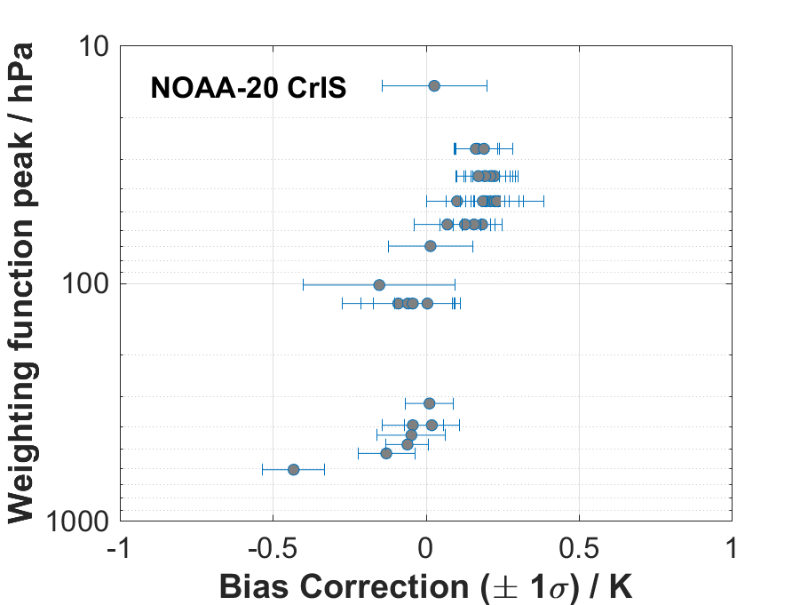
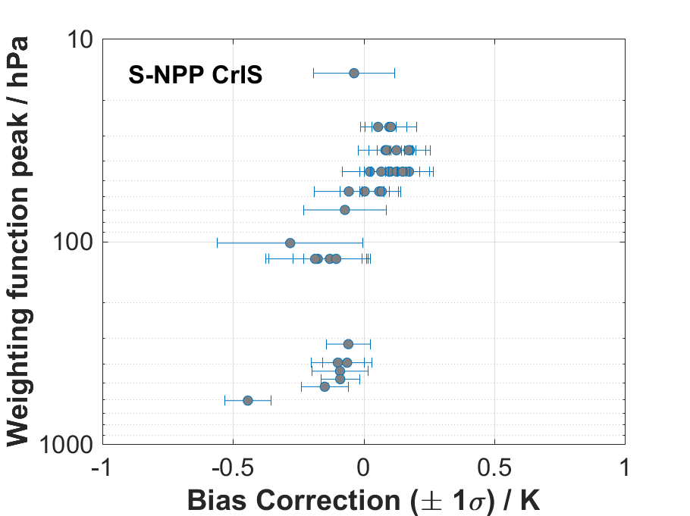
Validating the mean state uncertainties
Several components of the observing system
could be considered ‘reference’ quality:
GNSS-RO - direct traceability chain to time standards
GRUAN radiosondes – available post-2010 in numbers
CrIS - well characterised uncertainties
GMI – reference MW imager mission
Use (a subset of) these observations passively
(i.e. withhold from the analysis) to assess
the uncertainty estimates from a benchmark period in
the ERA6 reanalysis (~ 2010-2020, or 2015-2025)
Benchmark* - defined in this context as
“ associated with robustly defined uncertainties
ideally validated through comparison with traceable independent
measurements ”
(borrowed from CLARREO, TRUTHS
mission concepts)
Error bars show
standard deviation of
the applied bias
correction for all obs
in the cycle
Bias corrections for
CrIS mostly
smaller than the
radiometric
uncertainties (±0.14K)

Slide 6
Impact on mean temperatures and humidities

Slide 7
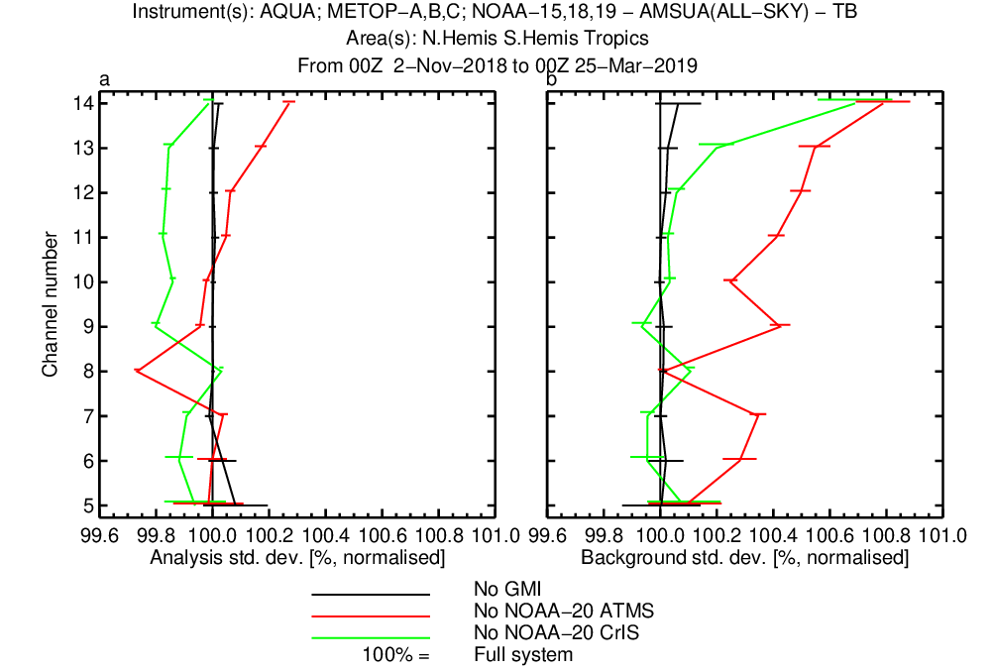
Analysis and background fits to AMSU-A observations

Slide 8
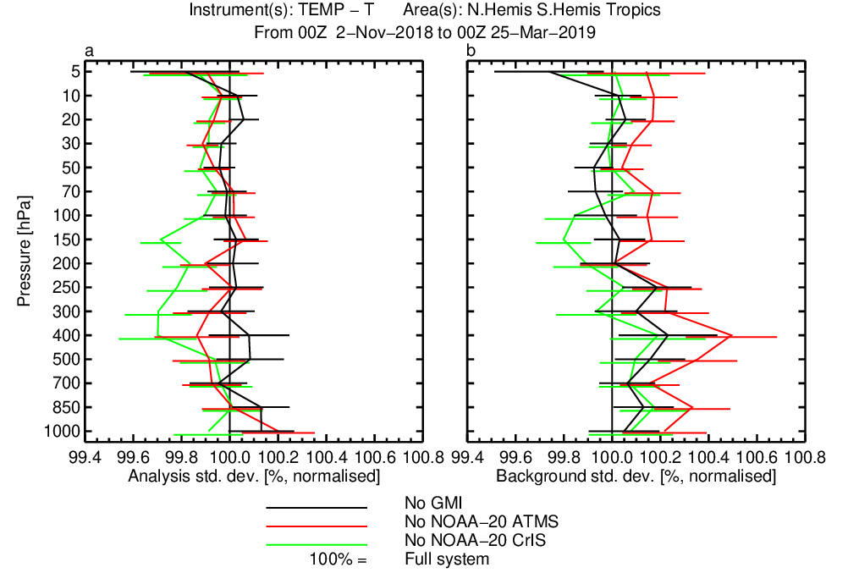
Background fits to radiosonde temperature observations

